Slide 1




NEXT GEN EMPLOYABILITY PROGRAM
Creating a future-ready workforce
Team Members
College Name
Student Name : SHYNUKA J
Student ID : 311121104054
LOYOLA- ICAM COLLEGE OF ENGINEERING AND TECHNOLOGY

Slide 2

CAPSTONE PROJECT SHOWCASE
Project Title
MUSIC WEB APPLICATION USING DJANGO FRAMEWORK
Abstract | Problem Statement | Project Overview | Proposed Solution | Technology Used | Modelling & Results | Conclusion

Slide 3
Abstract
The music web application, powered by the Django framework, delivers a dynamic platform for music enthusiasts to explore and engage with a wide range of musical content. Its core features include showcasing trending songs and enabling users to create a personalized 'Listen Later' list. The user interface is designed to be visually engaging with a carousel display, drawing attention to important content. Behind the scenes, Django's robust backend ensures scalability and security, capable of handling a large volume of users and music content. Users can actively engage with the application by listening to songs, adding them to their 'Listen Later' list, and exploring detailed song information, creating an immersive music discovery and listening experience. Overall, the music web application using Django offers a seamless and comprehensive platform for users to explore, discover, and enjoy music, making it an invaluable tool for music enthusiasts
Source :

Slide 4
Problem Statement
In the digital age, music enthusiasts often struggle to discover new and trending songs tailored to their tastes. Existing music platforms lack personalized features and interactive interfaces, limiting users' ability to explore and enjoy music. To address this issue, we aim to develop a music web application using the Django framework that provides users with a curated selection of trending songs and personalized playlists. The application will offer a visually appealing interface with detailed song information and a 'Listen Later' feature, allowing users to save and revisit their favorite songs. By combining Django's backend capabilities with a user-friendly frontend, our goal is to create an engaging and immersive music discovery experience for users.
Source :

Slide 5
Project Overview
User Authentication and Profiles: The application will have a user authentication system where users can create accounts, log in, and manage their profiles. This allows for a personalized experience, as users can save their preferences and playlists.
Music Discovery: The application will feature a curated selection of trending songs, as well as the ability for users to explore music based on genres, artists, and albums. This ensures that users can easily discover new music that aligns with their tastes.
Personalized Playlists: Users will be able to create and manage their playlists, adding songs from the application's music library. This feature allows for a customized music listening experience, where users can create playlists for different moods or occasions.
Song Details and Listening Options: Each song will have detailed information displayed, including title, artist, album, and genre. Users will also have the option to listen to a preview of the song before adding it to their playlists.
Listen Later: This feature allows users to save songs to listen to later, ensuring that they can easily access songs they are interested in without having to search for them again.
Responsive Design: The application will be designed to be responsive, ensuring that users can access and enjoy the application seamlessly across devices, including desktops, tablets, and smartphones.
Source :

Slide 6
Proposed Solution
.
Backend Development with Django: Django will be used to develop the backend of the application, including user authentication, database management, and API integration for music streaming.
Frontend Development with HTML, CSS, and JavaScript: The frontend of the application will be developed using HTML, CSS, and JavaScript to create a responsive and interactive user interface.
User Authentication and Profiles: Django's built-in authentication system will be used to handle user registration, login, and profile management. Users will be able to create accounts, log in securely, and manage their profile information.
Music Library and Database Management: The application will feature a music library that users can browse, search, and explore. A database management system will be implemented to store and manage the music catalog, user data, and playlist information.
Source :

Slide 7
​
Music Discovery and Recommendation: The application will provide users with personalized music recommendations based on their listening history, preferences, and trends. Users will be able to discover new music and artists through curated playlists and recommendations.​
​
Playlist Management: Users will have the ability to create, edit, and delete playlists. They can add songs to their playlists from the music library and reorder songs as desired. Users can also share their playlists with others.​
​
Responsive Design and Cross-Device Compatibility: The application will be designed to be responsive, ensuring that it works seamlessly across a range of devices, including desktops, laptops, tablets, and smartphones.​
​
Security and Data Privacy: The application will implement security best practices to protect user data and ensure data privacy. This includes secure authentication, data encryption, and adherence to privacy regulations.​
Source :

Slide 8


Technology Used
Front-end
Back-end
Source :

Slide 9
Modelling & Results
User Model: Represents a user of the application. Includes fields for username, email, password, and other relevant information.
Song Model: Represents a song in the music library. Includes fields for the song's name, artist, album, genre, duration, release date, and file upload for the song's audio file.
Playlist Model: Represents a playlist created by a user. Includes fields for the playlist's name, description, creator (foreign key to User model), and many-to-many relationship with Song model for the songs in the playlist.
Interaction Models: Includes models for user interactions such as liking a song, adding a song to a playlist, following other users, and listening history. These models capture user engagement and help personalize the user experience.
Results: The results of the project would include a fully functional music streaming application with features such as user authentication, song browsing, playlist creation and management, user interactions, and a responsive user interface. The application would allow users to discover, listen to, and interact with music in a seamless and enjoyable manner.
Source :

Slide 10
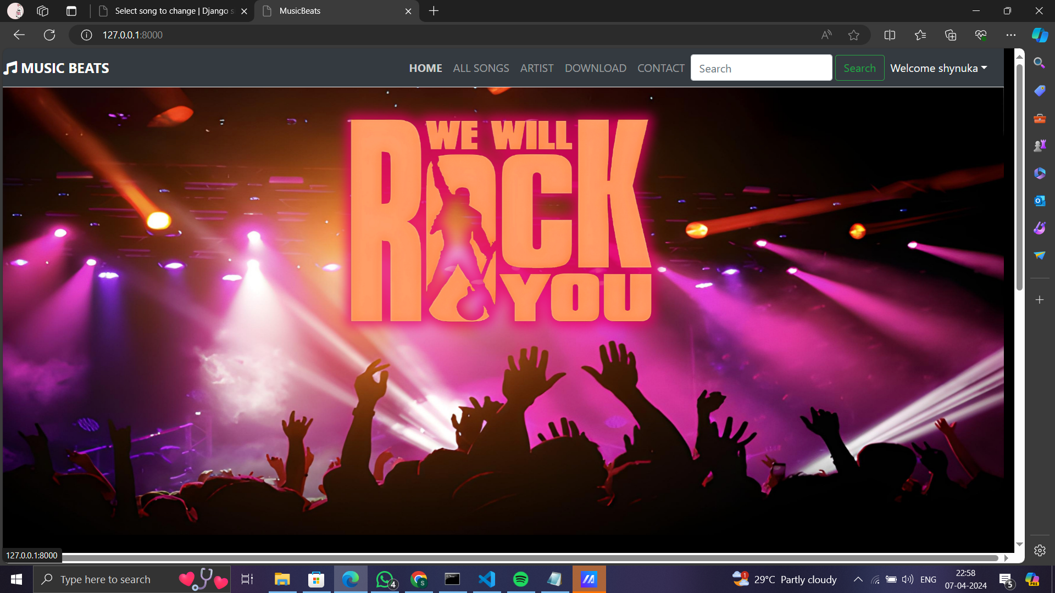
HOMEPAGE

Slide 11
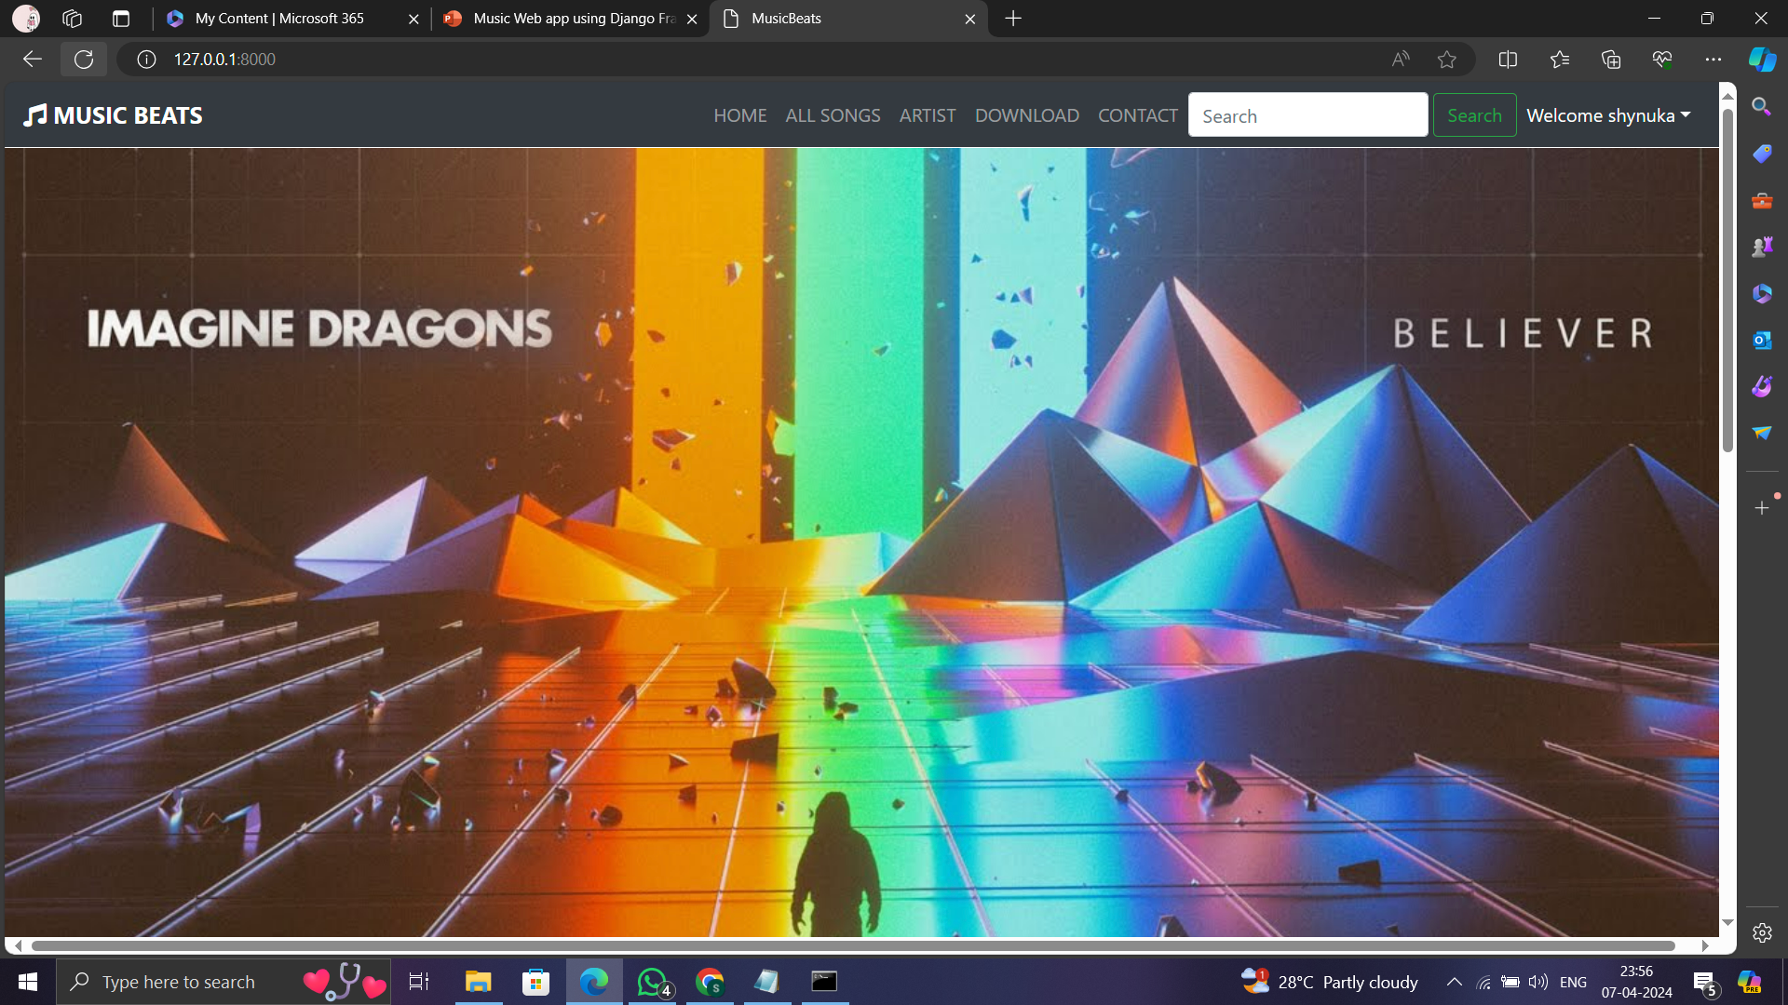
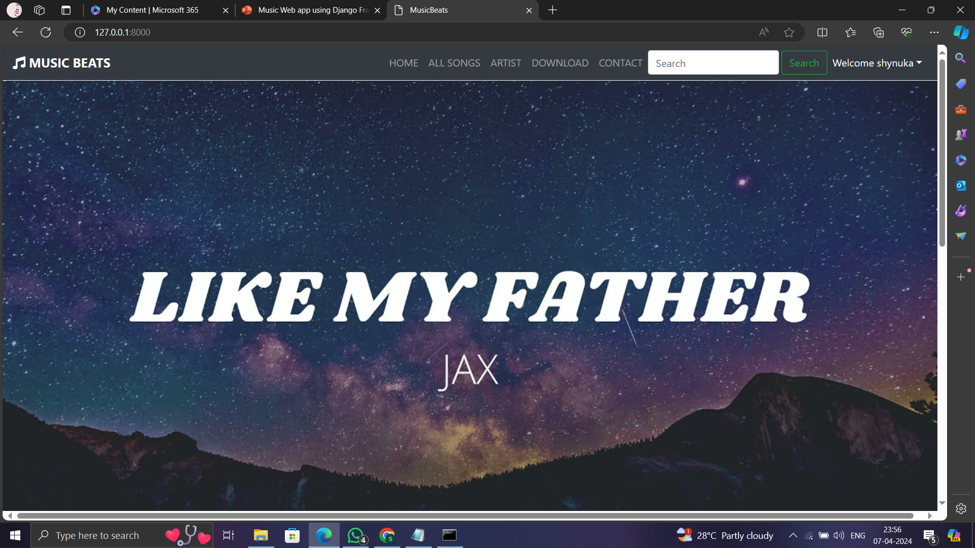
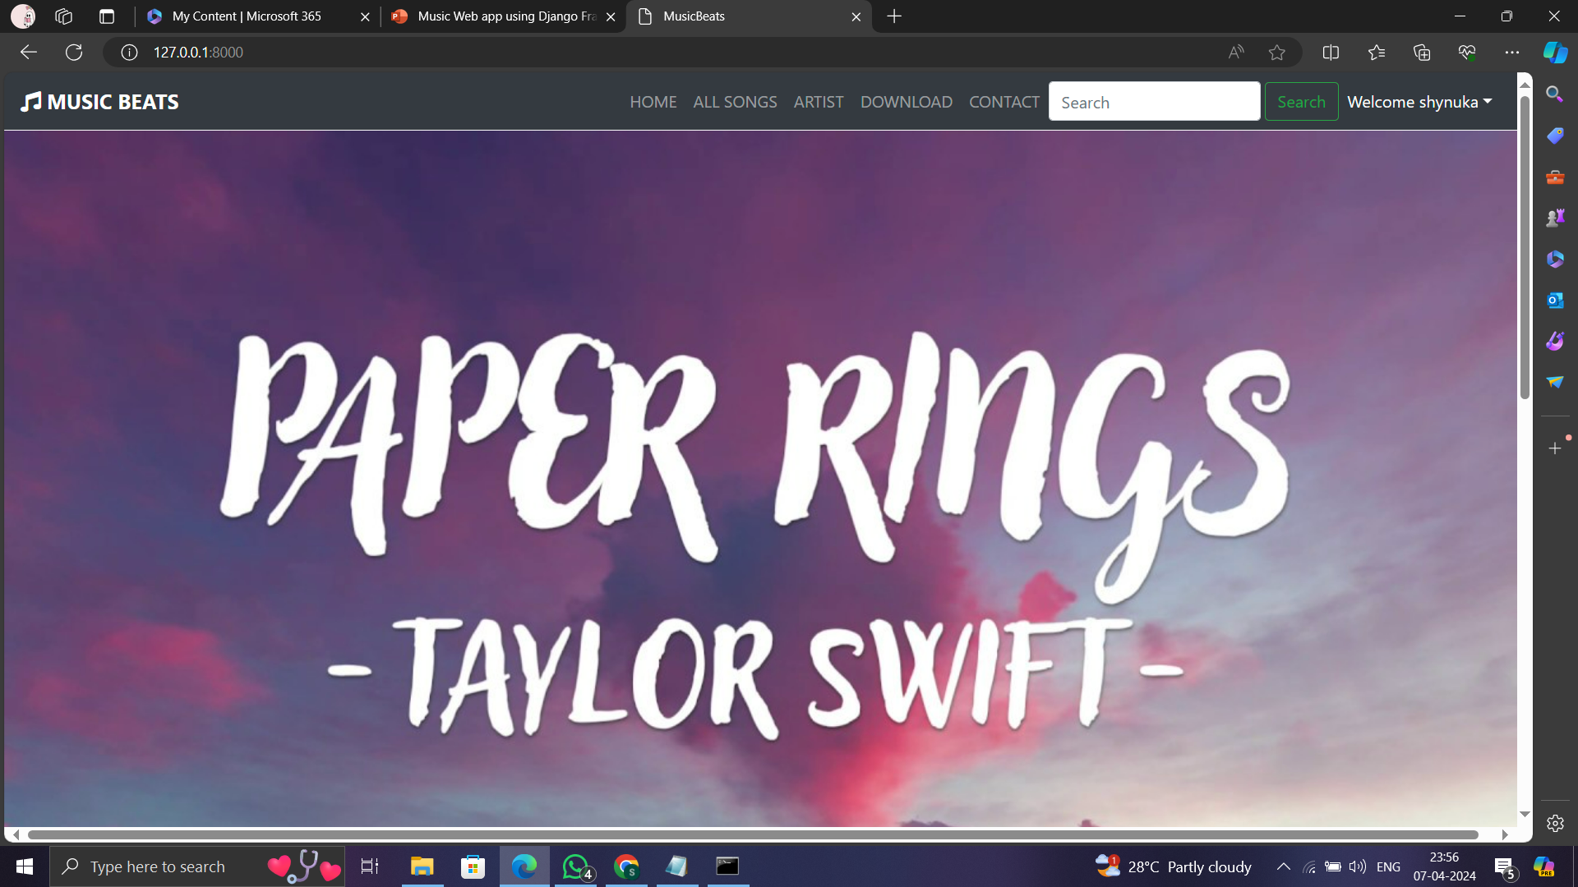
HOMEPAGE

Slide 12
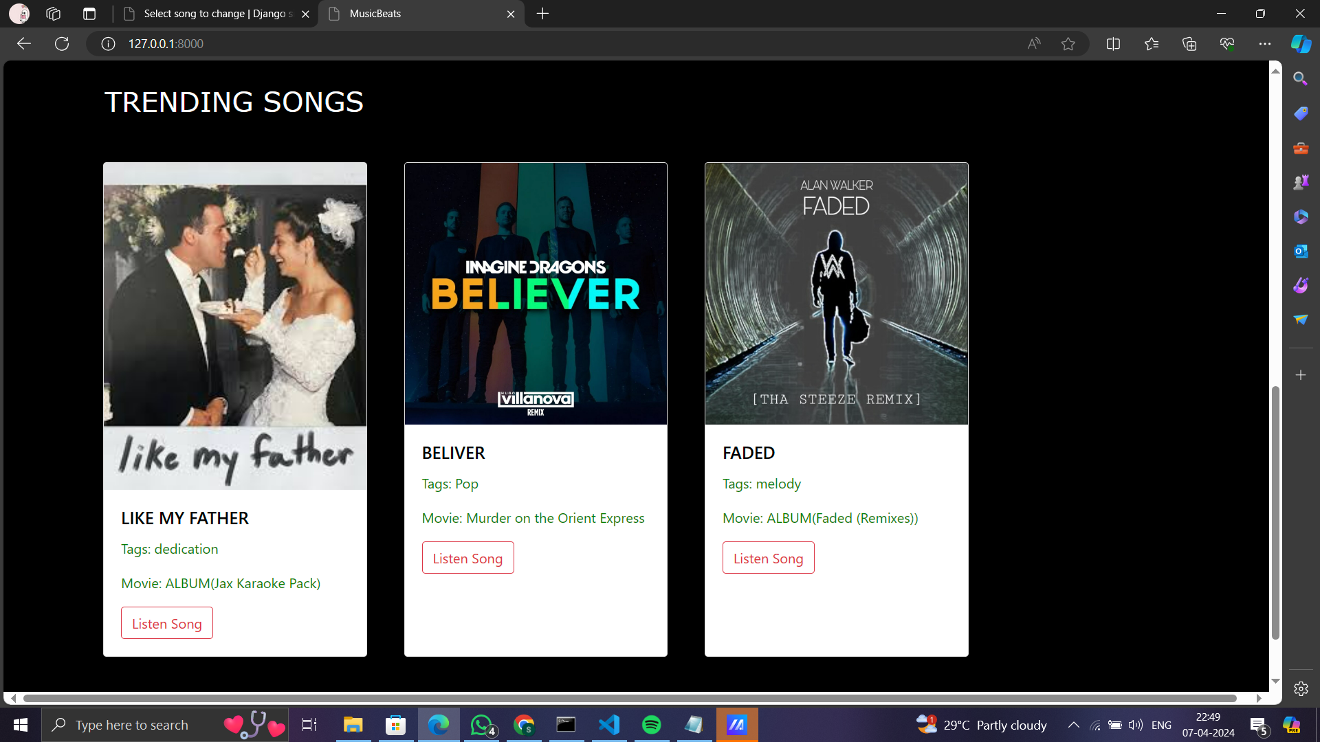
INDEX PAGE

Slide 13
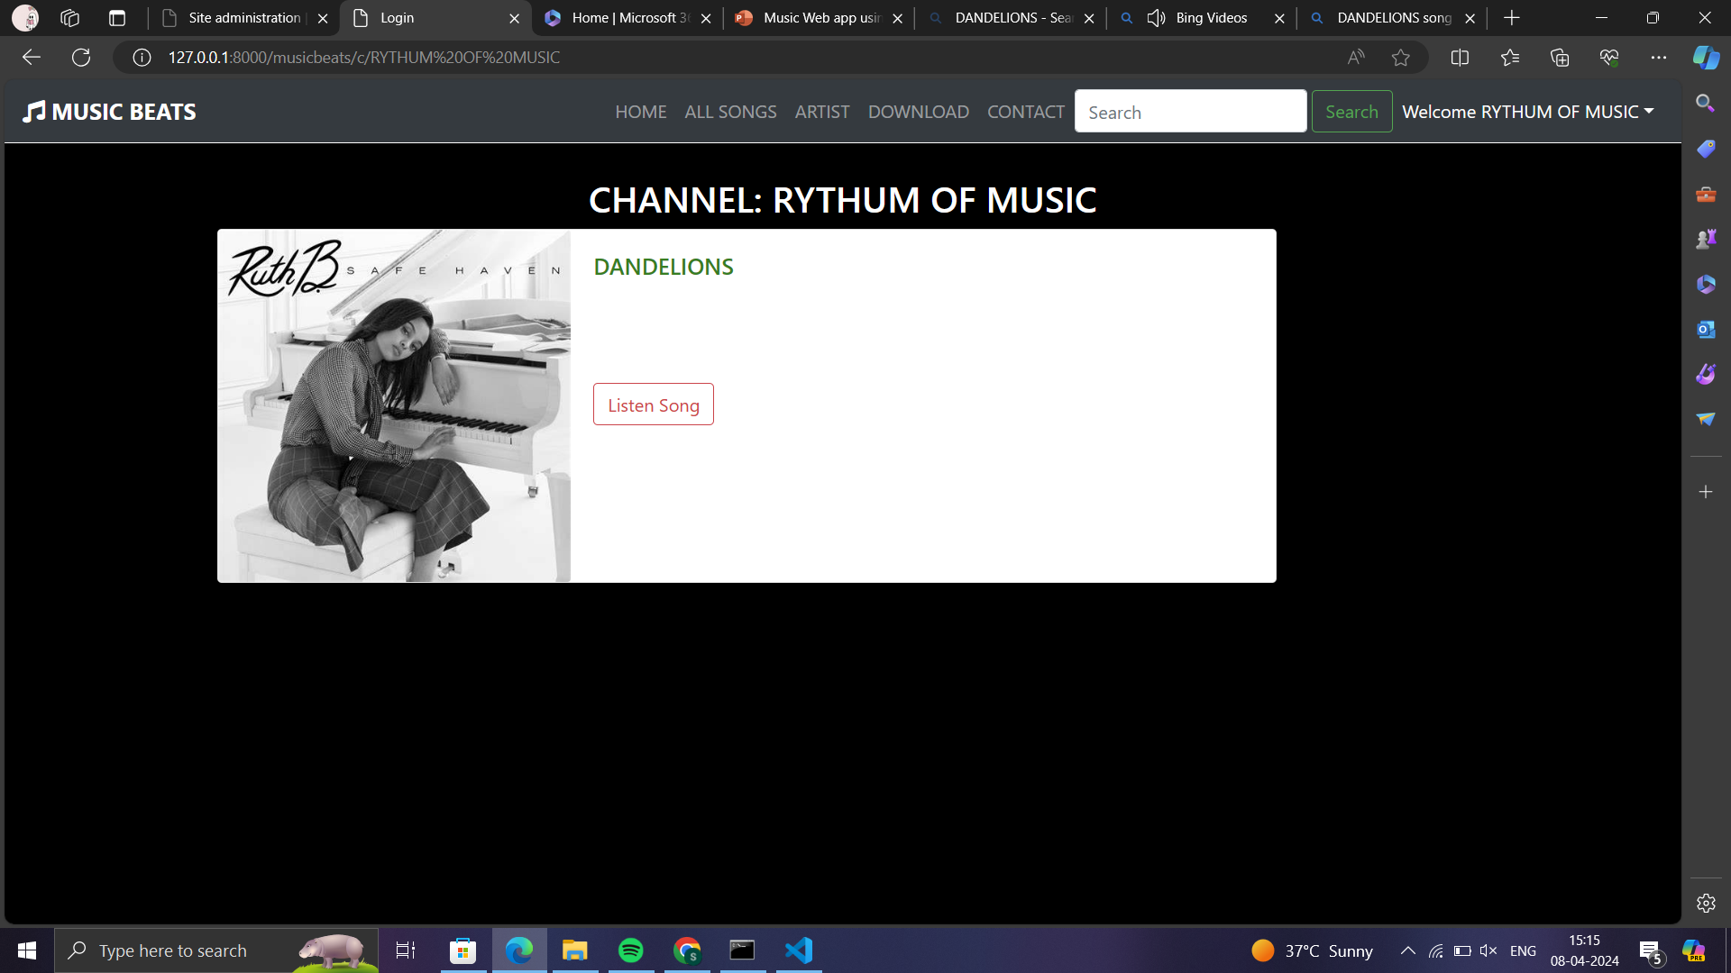
CHANNEL PAGE

Slide 14
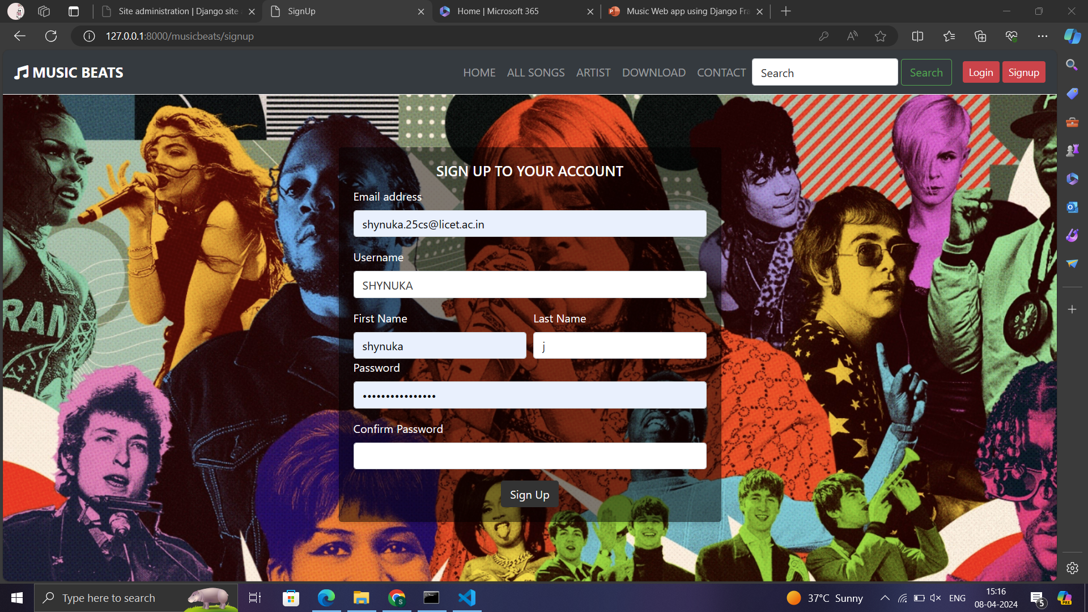
SIGN-UP PAGE

Slide 15
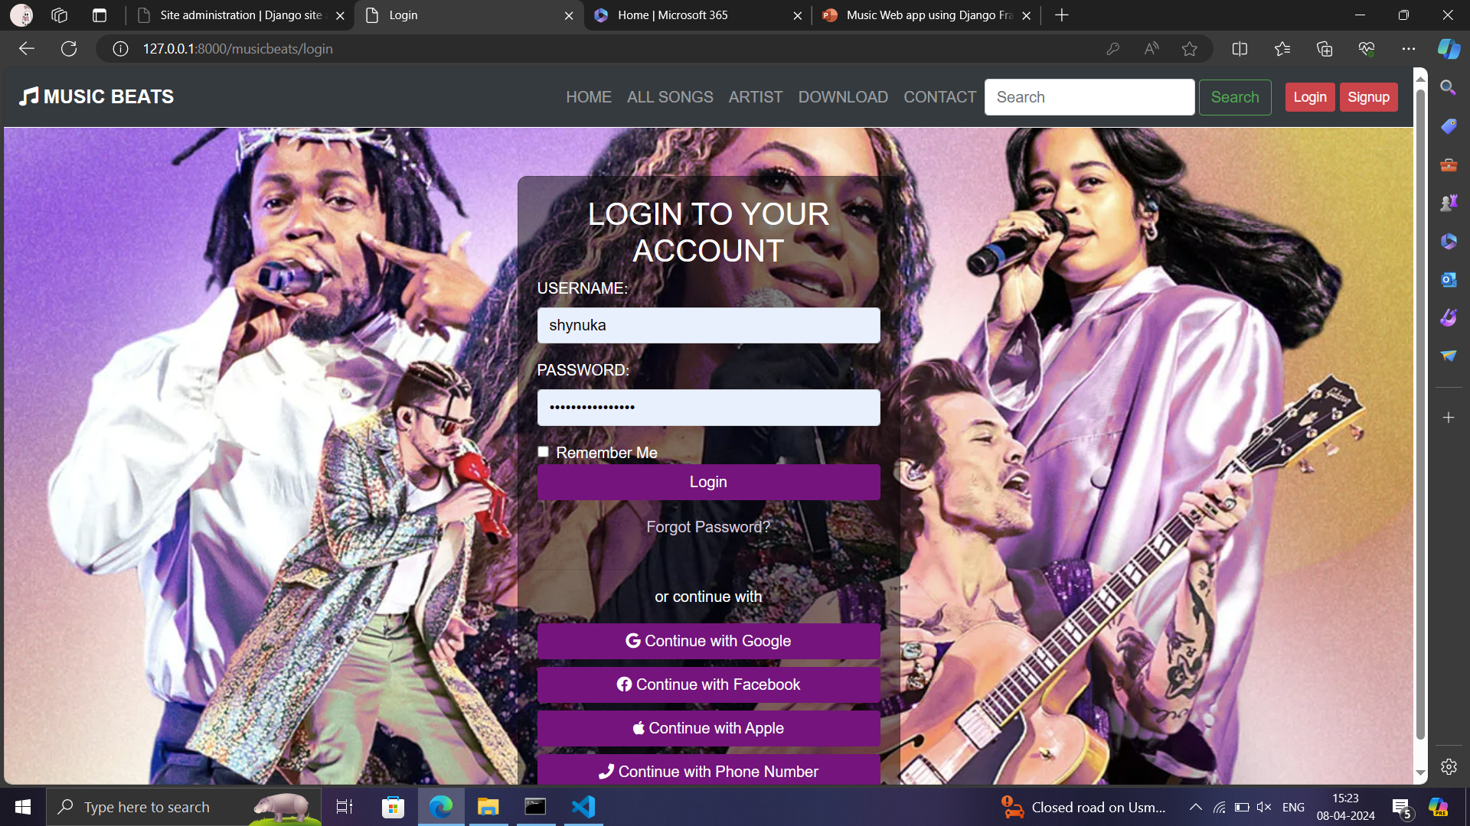
LOGIN PAGE

Slide 16
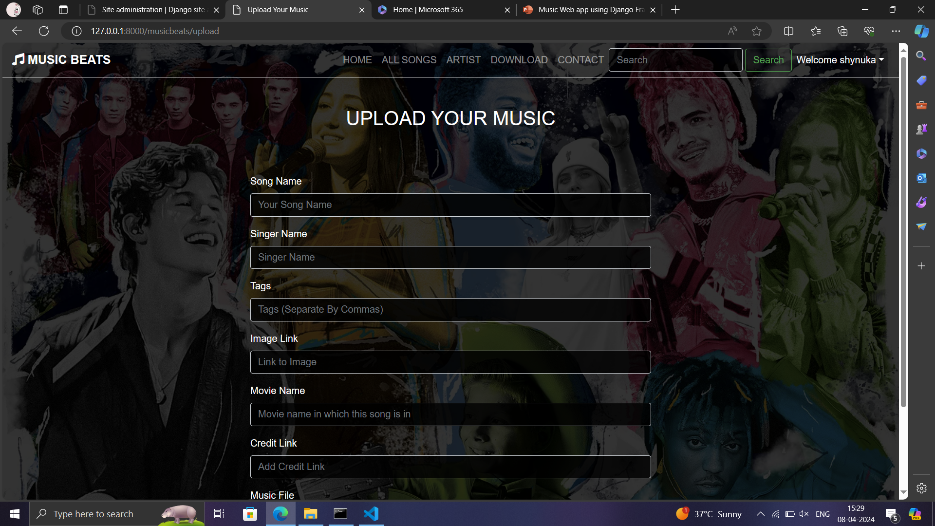
UPLOAD MUSIC PAGE

Slide 17
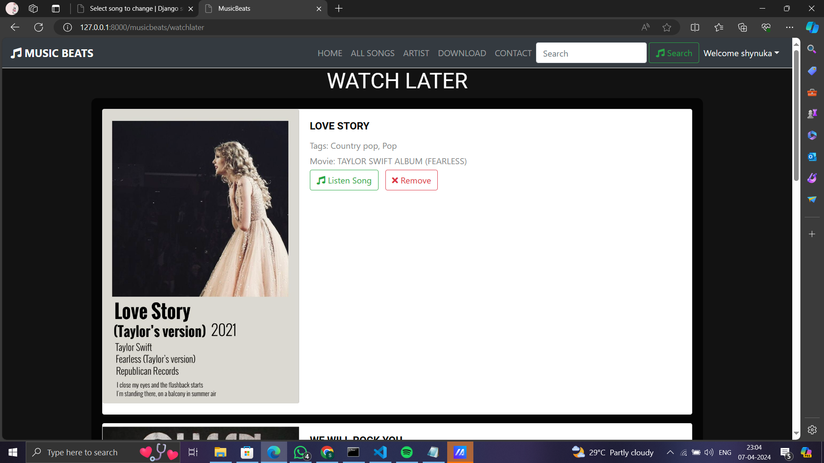
WATCH LATER PAGE

Slide 18
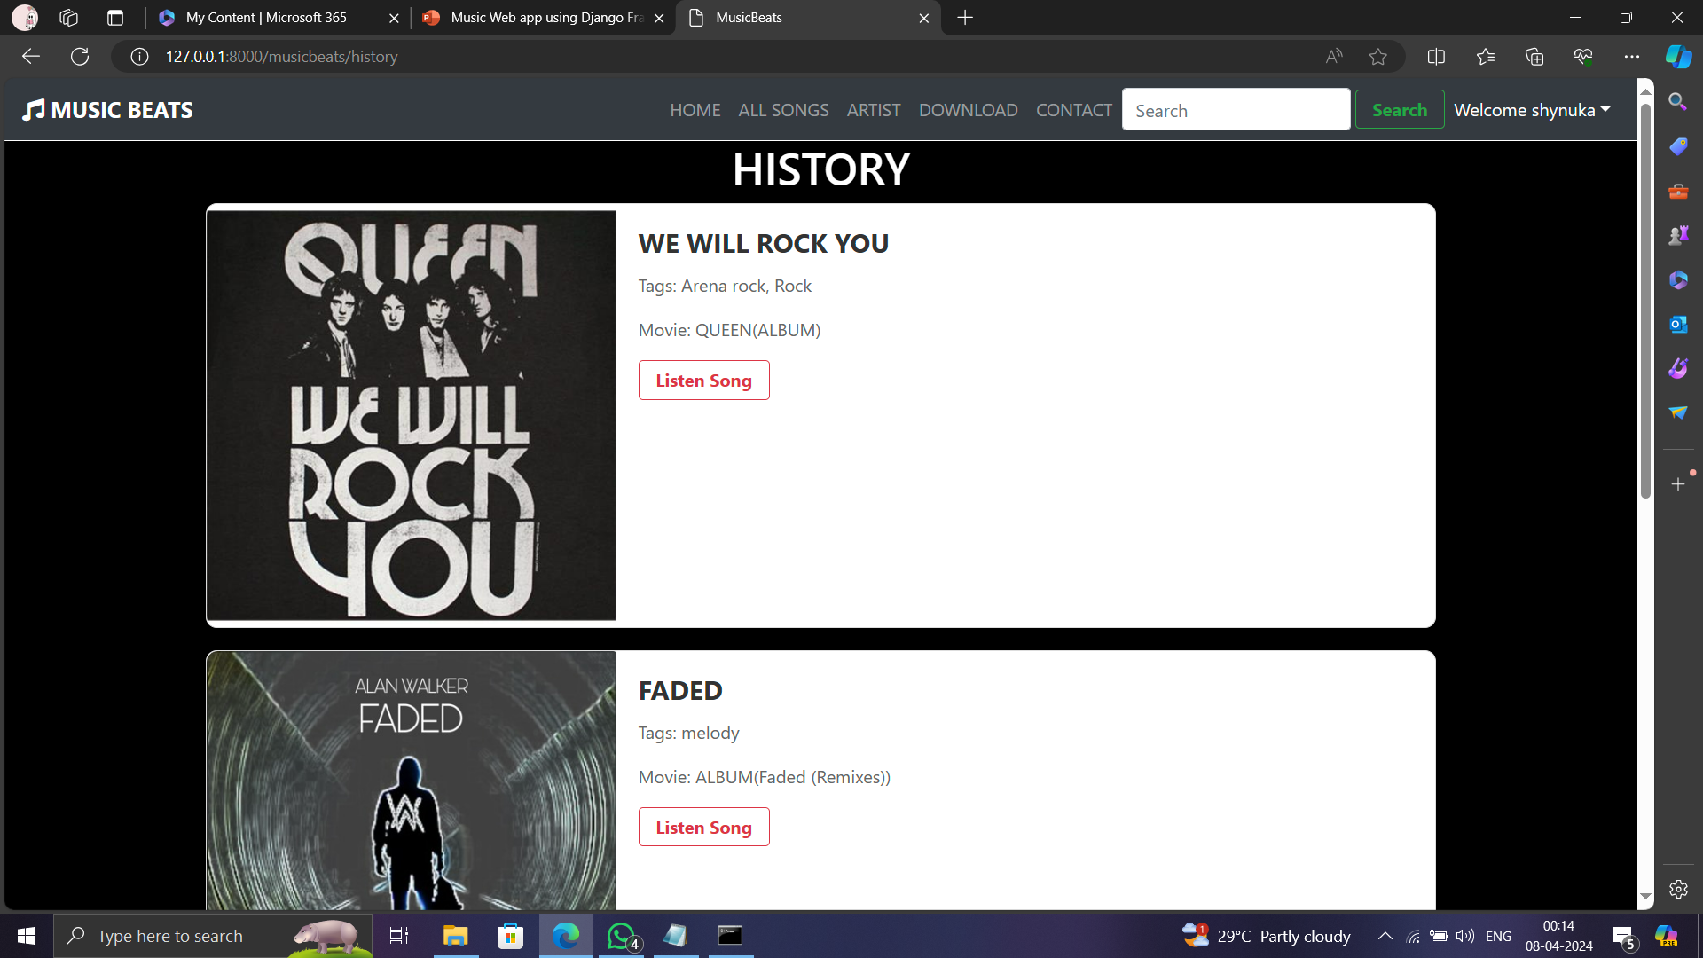
HISTORY PAGE

Slide 19
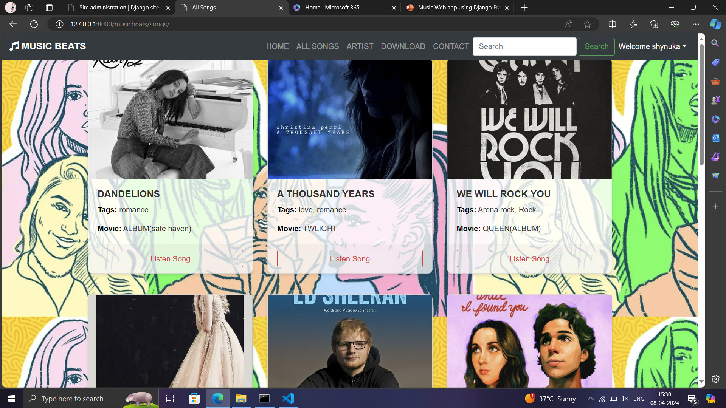
SONGS PAGE

Slide 20
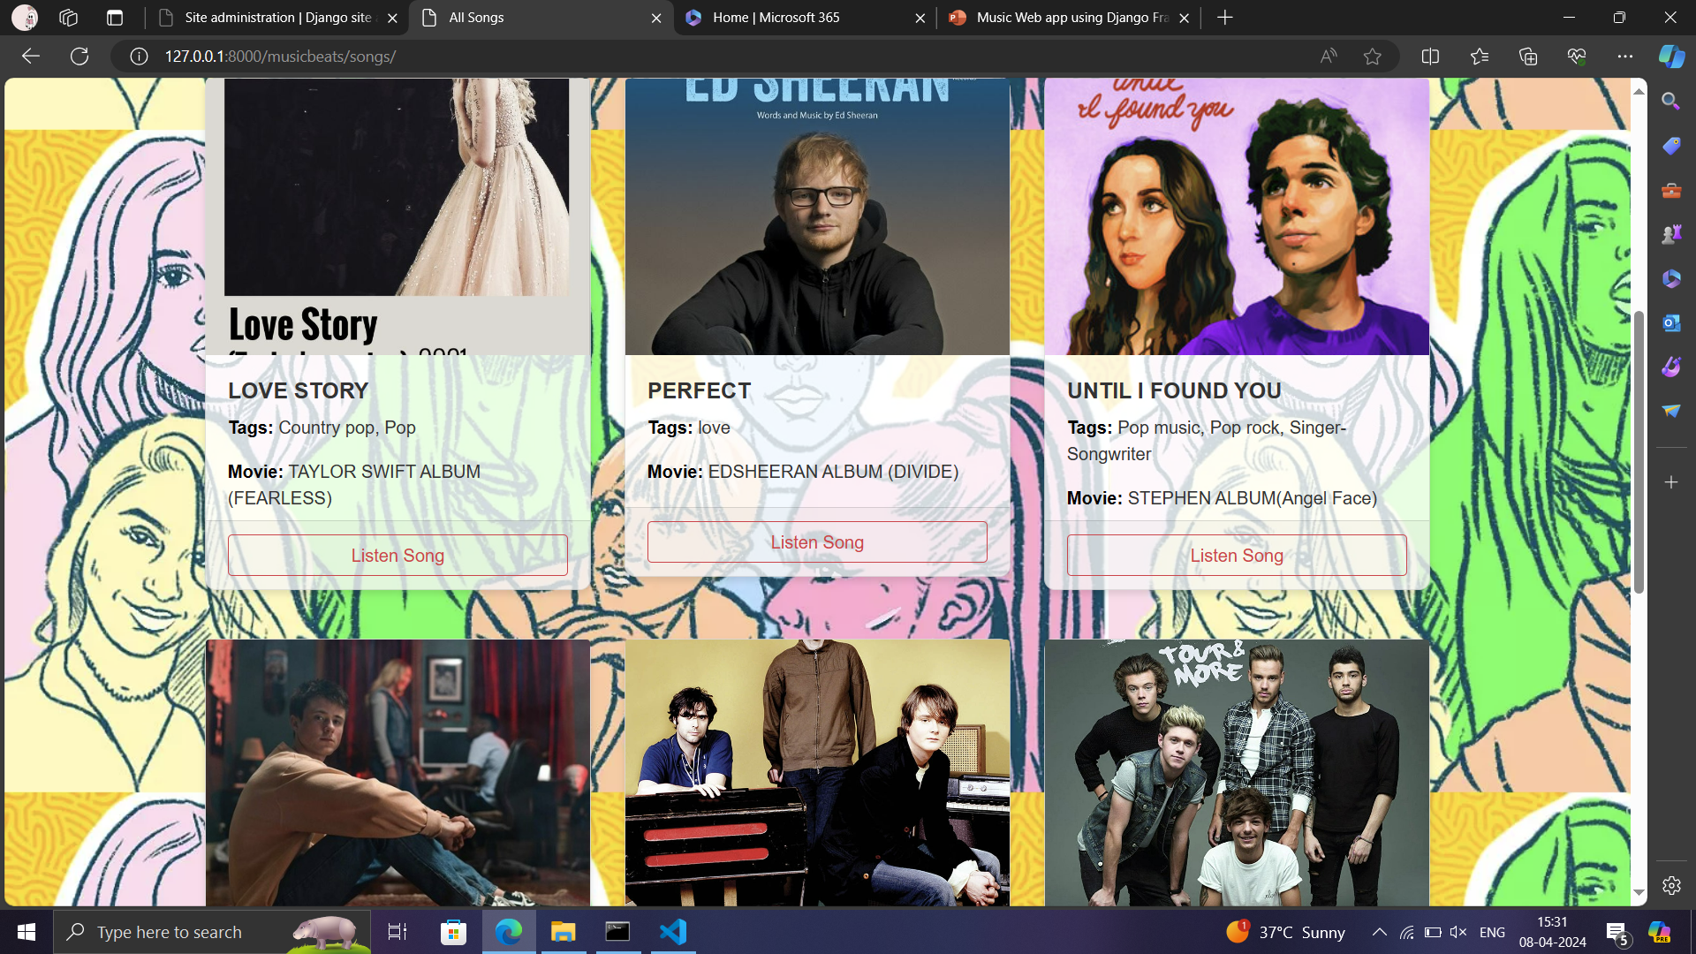
SONGS PAGE

Slide 21
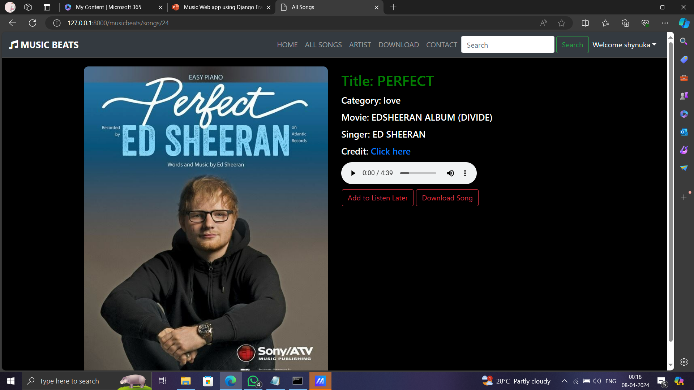
SONG POST PAGE

Slide 22
Future Enhancements:
Social Sharing: Allow users to share their playlists or favorite songs on social media platforms, increasing engagement and user interaction.
Advanced Recommendations: Implement more advanced recommendation algorithms, such as collaborative filtering or content-based filtering, to provide more personalized music suggestions to users.
User Profiles: Create user profiles where users can add a profile picture, bio, and customize their preferences, enhancing the personalization of the app.
Lyrics Integration: Integrate a lyrics API to display song lyrics alongside the music player, enhancing the listening experience for users.
Improved Player Controls: Add more features to the music player, such as shuffle, repeat, and a progress bar showing the current playback position of the song.

Slide 23
Future Enhancements:
6. Curated Playlists: Create curated playlists curated by music experts or algorithms based on user preferences, providing users with a diverse selection of music to discover.
7. Offline Listening: Implement offline listening capabilities, allowing users to download songs or playlists for offline playback, ideal for users with limited internet access.
8. Live Streaming: Introduce live streaming features for concerts, music festivals, or exclusive artist performances, offering users a unique and immersive music experience.
9. Podcast Support: Expand the platform to include podcasts, allowing users to discover, subscribe to, and listen to their favorite podcasts alongside music content.
10. Accessibility Features: Improve accessibility by adding features such as closed captions for song lyrics, screen reader compatibility, and keyboard navigation for users with disabilities.

Slide 24
Conclusion:
The proposed music streaming web application built using the Django framework offers a comprehensive platform for users to discover, listen to, and interact with music. The application leverages Django's powerful features to provide a user-friendly interface, secure authentication, and efficient data management.
Through its intuitive design and robust functionality, the application aims to enhance the music listening experience for users by offering a wide range of songs, playlists, and features. Additionally, the application's future enhancements, such as social sharing, advanced recommendations, and offline listening, further contribute to its appeal and utility.
Overall, the music streaming web application represents a significant advancement in music technology, providing users with a modern and immersive music experience.
Source :

Slide 25
Thank You!
Notes:
Thank You !!

